Slide 1



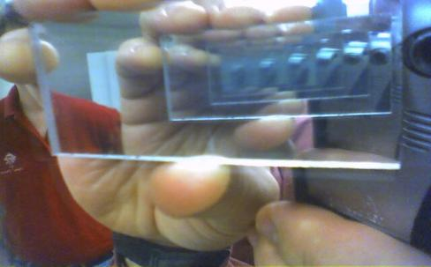
Recursion
Recursive Algorithms
and Backtracking
Recursion
SoftUni Team
Technical Trainers
Software University
http://softuni.bg

Slide 2

Table of Contents
Recursion
Generating 0/1 Vectors and Combinations
Backtracking
  The 8 Queens Problem
  Finding All Paths in a Labyrinth Recursively
Recursion or Iteration?
  Harmful Recursion and Optimizing Bad Recursion

Slide 3


The Stack
"The stack" is a small fixed-size chunk of memory (e.g. 1MB)
Keeps track of the point to which each active subroutine should return control when it finishes executing
Call Stack
call
call
Main
Method A
Main
Method A
Method B
START
Method B
return
return

Slide 4
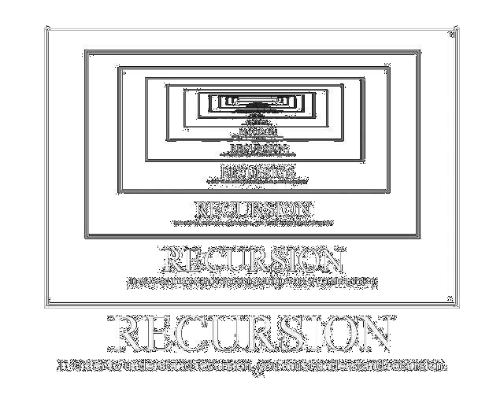
What is Recursion?

Slide 5
What is Recursion?
Problem solving technique (In CS)
Divides a problem into subproblems of the same type
  Involves a function calling itself
  The function should have a base case
  Each step of the recursion should move towards the base case
Sum(array)
array[0] + Sum(sub-array)
1 | 2 | 3 | 4 | 5
1
2 | 3 | 4 | 5

Slide 6
Array Sum – Example
Sum(n - 1)
1
2 | 3 | 4
Sum(n)
Sum((n – 1) - 1)
1 | 2 | 3 | 4
1
2
3 | 4
Sum(((n – 1) - 1) – 1)
1
2
3
4
Base case

Slide 7
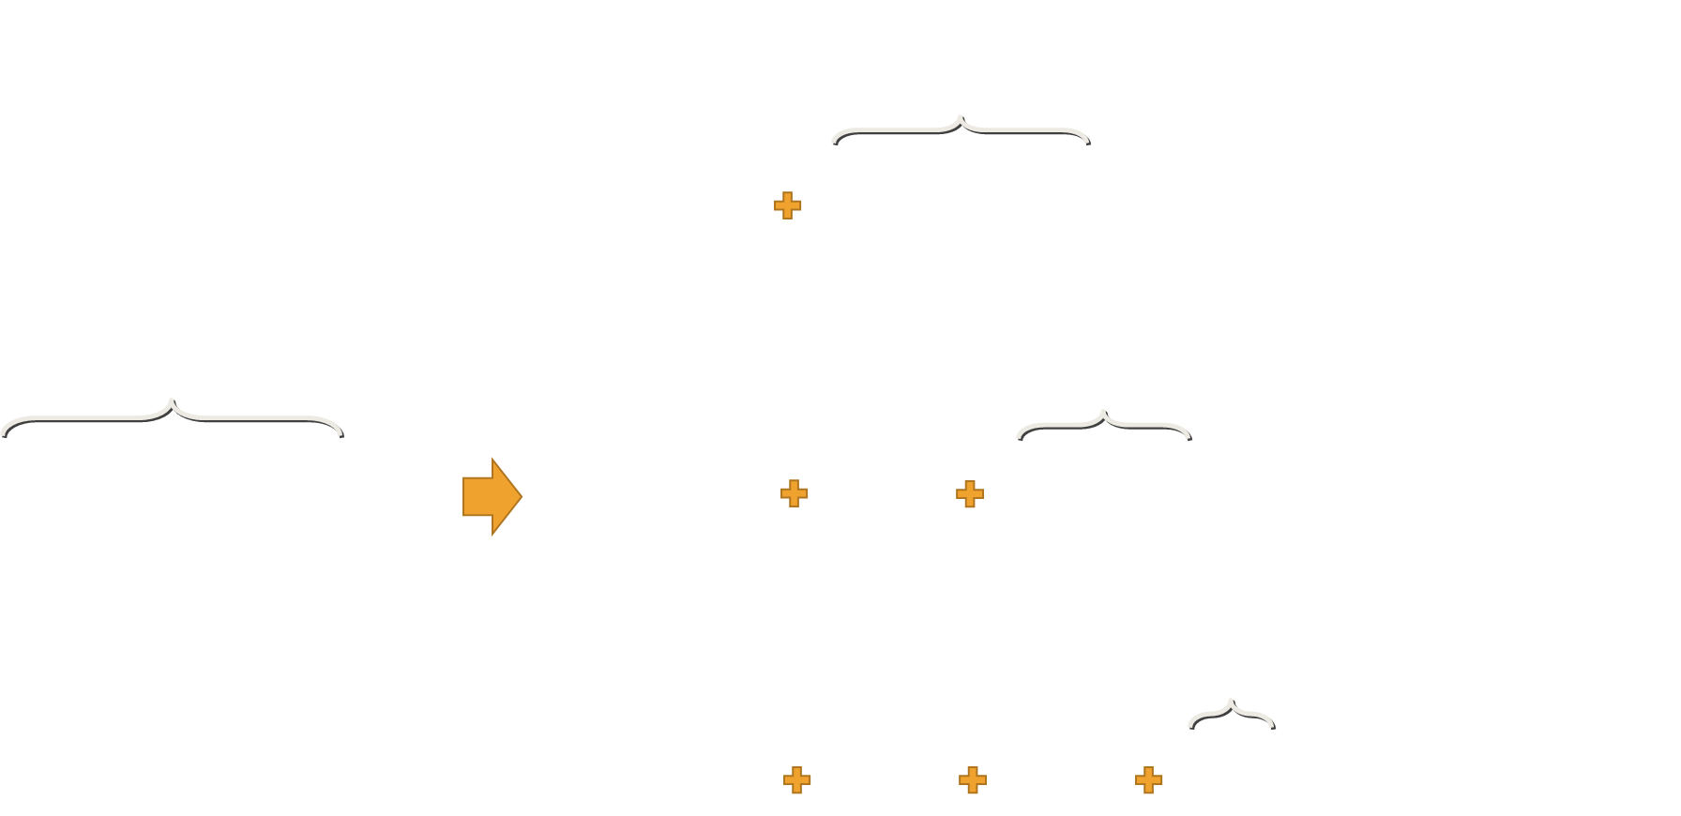
Problem: Array Sum
Create a recursive method that
  Finds the sum of all numbers stored in an int[] array
  Read numbers from the console
1 2 3 4
10
-1 0 1
0

Slide 8
Solution: Array Sum
static int Sum(int[] array, int index)
{
if (index == array.Length - 1)
{
return array[index];
}
return array[index] + Sum(array, index + 1);
}
Base case

Slide 9
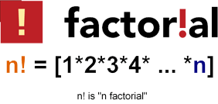
Recursive Factorial – Example
Recursive definition of n! (n factorial):
n! = n * (n–1)! for n > 0
0! = 1
5! = 5 * 4!
  4! = 4 * 3!
    3! = 3 * 2!
      2! = 2 * 1!
        1! = 1 * 0!
0! = 1

Slide 10
Problem: Recursive Factorial
Create a recursive method that calculates n!
  Read n from the console
5
120
10
3628800

Slide 11
Solution: Recursive Factorial
static long Factorial(int num)
{
if (num == 0)
{
return 1;
}
return num * Factorial(num - 1);
}
Base case

Slide 12
Direct and Indirect Recursion
void A() {
…
A();
}
Direct recursion
  A method directly calls itself
Indirect recursion
  Method A calls B, method B calls A
  Or even A → B → C → A
Funny example of infinite indirect recursion:
  http://www.nakov.com/blog/2013/01/23/indirect-recursion/
void A() {
…
B();
}
void B() {
…
A();
}

Slide 13
Recursion Pre-Actions and Post-Actions
Recursive methods have 3 parts:
  Pre-actions (before calling the recursion)
  Recursive calls (step-in)
  Post-actions (after returning from recursion)
static void Recursion()
{
// Pre-actions
Recursion();
// Post-actions
}

Slide 14
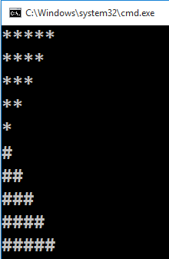
Problem: Recursive Drawing
Create a recursive method that draws the following figure
5

Slide 15
Pre-Actions and Post-Actions – Example
static void PrintFigure(int n)
{
if (n == 0) // Bottom of the recursion
return;
// Pre-action: print n asterisks
Console.WriteLine(new string('*', n));
// Recursive call: print figure of size n-1
PrintFigure(n - 1);
// Post-action: print n hashtags
Console.WriteLine(new string('#', n));
}

Slide 16

Recursion
Live Exercises in Class (Lab)

Slide 17

Generating Combinations
Recursive Algorithm

Slide 18

Generating 0/1 Vectors
How to generate all 8-bit vectors recursively?
    0 0 0 0 0 0 0 0
    0 0 0 0 0 0 0 1
    ...
    0 1 1 1 1 1 1 1
    1 0 0 0 0 0 0 0
    ...
    1 1 1 1 1 1 1 0
    1 1 1 1 1 1 1 1

Slide 19
Generating 0/1 Vectors
Start with a blank vector
Choose the first position and loop through all possibilities
For each possibility, generate all (n – 1)-bit vectors
x | x | x | x | x | x | x
0 | x | x | x | x | x | x
1 | x | x | x | x | x | x
n - 1
n - 1

Slide 20
Problem: Generate n-bit Vectors
Generate all n-bit vectors as shown below
Read n from the console
8-bit vectors in lexicographic order
0 0 0 0 0 0 0 0
0 0 0 0 0 0 0 1
...
0 1 1 1 1 1 1 1
1 0 0 0 0 0 0 0
...
1 1 1 1 1 1 1 0
1 1 1 1 1 1 1 1
8

Slide 21
Solution: Generate n-bit Vectors
static void Gen01(int index, int[] vector)
{
if (index >= vector.Length)
Print(vector);
else
for (int i = 0; i <= 1; i++)
{
vector[index] = i;
Gen01(index + 1, vector);
}
}
static void Main()
{
int n = 8;
int[] vector = new int[n];
Gen01(0, vector);
}

Slide 22
Generating 3-bit Vectors Recursion Tree
length = 3
0
vector:
x | x | x
0
1
1
1
0
1
0
1
2
2
2
2
0
1
0
1
0
1
0
1
3
3
3
3
3
3
3
3
Print Vector

Slide 23
Generating 3-bit Vectors Trace
 | vector | index
Gen() | 0 0 0 | 2
Gen() | 0 0 0 | 1
Gen() | 0 0 0 | 0
Gen() | 0 0 0 | -1
Gen() | 0 0 1 | 0
Gen() | 0 0 1 | -1
Gen() | 0 0 1 | 0
Gen() | 0 1 0 | 1
Gen() | 0 1 0 | 0
Gen() | 0 1 0 | -1
Gen() | 0 1 1 | 0
Gen() | 0 1 1 | -1
… | … | …
Print Vector
Print Vector
Print Vector
Print Vector

Slide 24



Generating Combinations
Combinations - all the ways to extract a subset from a set
  Select k members from a set of n elements
Example:
  2 different elements from {1, 2, 3, 4} → 6 different ways:
(1, 2) (1, 3) (1, 4) (2, 3) (2, 4) (3, 4)

Slide 25
Generating Combinations (2)
Algorithm GenCombs(k): put the numbers [0 … n] at position k and call GenCombs(k+1) recursively for the rest of the elements:
GenCombs(0):
GenCombs(1):
GenCombs(n):
Print;
Stop!
0 | x | x | x | x | x | x
→
0 | 1 | x | x | x | x | x
…
GenCombs(1)
GenCombs(2)
Put all numbers in range [0..n - 1] at position k
Put all numbers in range [1..n - 1] at position k
Bottom of recursion

Slide 26
Generating Combinations (3)
private static void GenCombs(
int[] set, int[] vector, int index, int border)
{
if (index >= vector.Length)
// Print vector
else
for (int i = border + 1; i < set.Length; i++)
{
vector[index] = set[i];
GenCombs(set, vector, index + 1, i);
}
}
}

Slide 27
Generating Combinations (3)
1 | 2 | 3 | 4
k = 2
1 | 2 | 3 | 4
k = 2
1 | 2 | 3 | 4
k = 2
1 | x
k = 1
2 | x
k = 1
3 | x
k = 1
1 | 2
1 | 4
2 | 3
2 | 4
3 | 4
1 | 3

Slide 28
Generating {1, 2, 3, 4}, k = 2
root
1
2
3
2
3
4
3
4
4

Slide 29
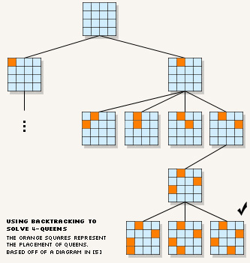
Backtracking
Generating All Candidates

Slide 30
Backtracking
What is backtracking?
  Class of algorithms for finding all solutions to some combinatorial problem
    E.g. find all paths from Sofia to Varna

Slide 31
Backtracking
How does backtracking work?
  At each step tries all perspective possibilities recursively
  Drop all non-perspective possibilities as early as possible
Backtracking has exponential running time!

Slide 32
Backtracking Algorithm (Pseudocode)
void Backtracking(Node node)
{
if (node is solution)
PrintSolution(node);
else
for each child c of node
if (c is perspective candidate)
{
MarkPositionVisited(c);
Backtracking(c);
UnmarkPositionVisited(c);
}
}

Slide 33
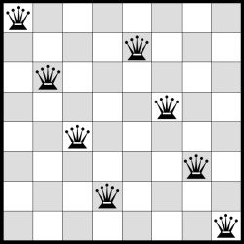
The "8 Queens" Puzzle
Backtracking in Practice

Slide 34
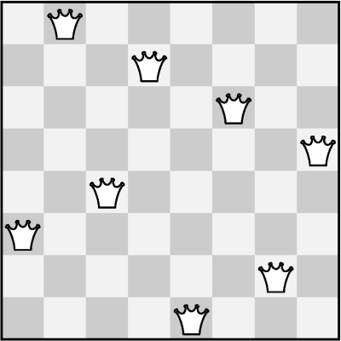
The "8 Queens" Puzzle
Write a program to find all possible placements of
  8 queens on a chessboard
  So that no two queens can attack each other
  http://en.wikipedia.org/wiki/Eight_queens_puzzle

Slide 35
Solving The "8 Queens" Puzzle
Find all solutions to
"8 Queens Puzzle"
At each step:
  Put a queen at free position
  Recursive call
  Remove the queen
void PutQueens(row)
{
if (row == 8)
PrintSolution();
else
for (col = 0 … 7)
if (CanPlaceQueen(row, col))
{
MarkAllAttackedPositions(row, col);
PutQueens(row + 1);
UnmarkAllAttackedPositions(row, col);
}
}

Slide 36
The "8 Queens" Puzzle
In-Class Exercise (Lab)

Slide 37
Finding All Paths in a Labyrinth
We are given a labyrinth
  Represented as matrix of cells of size M x N
  Empty cells (-) are passable, the others (*) are not
We start from the top left corner and can move in all 4 directions
We want to find all paths to the exit, marked 'e'
2
- | - | - | * | - | - | -
* | * | - | * | - | * | -
- | - | - | - | - | - | -
- | * | * | * | * | * | -
- | - | - | - | - | - | e
Start position
End position
3
1
4

Slide 38
Finding All Paths in a Labyrinth (2)
There are 3 different paths from the top left corner to the bottom right corner:
0 | 1 | 2 | *
* | * | 3 | * |  | *
6 | 5 | 4
7 | * | * | * | * | *
8 | 9 | 10 | 11 | 12 | 13 | 14
0 | 1 | 2 | * | 8 | 9 | 10
* | * | 3 | * | 7 | * | 11
 |  | 4 | 5 | 6 |  | 12
 | * | * | * | * | * | 13
 |  |  |  |  |  | 14
0 | 1 | 2 | *
* | * | 3 | * |  | *
 |  | 4 | 5 | 6 | 7 | 8
 | * | * | * | * | * | 9
 |  |  |  |  |  | 10
1)
2)
3)
RRDDLLDDRRRRRR
RRDDRRUURRDDDD
RRDDRRRRDD

Slide 39
Find All Paths: Algorithm
DS → matrix of characters:
  Dashes '-' are passable cells
  Asterisks '*' are not passable
  The symbol 'e' is the exit (can occur multiple times)
static char[,] lab =
{
{'-', '-', '-', '*', '-', '-', '-'},
{'*', '*', '-', '*', '-', '*', '-'},
{'-', '-', '-', '-', '-', '-', '-'},
{'-', '*', '*', '*', '*', '*', '-'},
{'-', '-', '-', '-', '-', '-', 'e'},
};

Slide 40
Find All Paths: Algorithm (2)
private static void FindPath(int row, int col)
{
if (!IsInBounds(row, col)) { return; }
if (IsExit(row, col)) { Console.WriteLine("Path found!"); }
else if (!IsVisited(row, col) && IsPassable(row, col))
{
Mark(row, col);
FindPath(row, col + 1); // Right
FindPath(row + 1, col); // Down
FindPath(row, col - 1); // Left
FindPath(row - 1, col); // Up
Unmark(row, col);
}
}

Slide 41
Find All Paths and Print Them
Create a List<char> that will store the path
Pass a direction at each recursive call (L, R, U or D)
At the start of each recursive call → Add direction
At the end of each recursive call → Remove last direction

Slide 42
Find All Paths and Print Them (2)
private static void FindPath(int row, int col, char direction)
{
if (!IsInBounds(row, col)) { return; }
path.Add(direction);
if (IsExit(row, col)) { PrintPath(); }
else if (!IsVisited(row, col) && IsFree(row, col))
{
Mark(row, col);
FindPath(row, col + 1, 'R');
FindPath(row + 1, col, 'D');
FindPath(row, col - 1, 'L');
FindPath(row - 1, col, 'U');
Unmark(row, col);
}
path.RemoveAt(path.Count - 1);
}

Slide 43
Recursion or Iteration?
When to Use and When to Avoid Recursion?

Slide 44
Performance: Recursion vs. Iteration
Recursive calls are slightly slower than iteration
  Parameters and return values travel through the stack at each step
  Prefer iteration for linear calculations (without branched calls)
Recursive factorial:
Iterative factorial:
static long RecurFact(int n)
{
if (n == 0)
return 1;
else
return n * Fact(n - 1);
}
static long IterFact(int num)
{
long result = 1;
for (int i = 1; i <= n; i++)
result *= i;
return result;
}

Slide 45
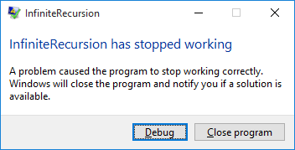
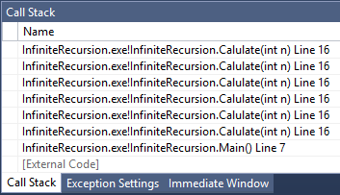

Infinite Recursion
Infinite recursion == a method calls itself infinitely
  Typically, infinite recursion == bug in the program
  The bottom of the recursion is missing or wrong
  In C# / Java / C++ causes "stack overflow" error
static long Calulate(int n)
{
return Calulate(n + 1);
}

Slide 46
Recursion Can be Harmful!
When used incorrectly recursion could take too much memory and computing power
static decimal Fibonacci(int n)
{
if ((n == 1) || (n == 2))
return 1;
else
return Fibonacci(n - 1) + Fibonacci(n - 2);
}
static void Main()
{
Console.WriteLine(Fibonacci(10)); // 89
Console.WriteLine(Fibonacci(50)); // This will hang!
}

Slide 47
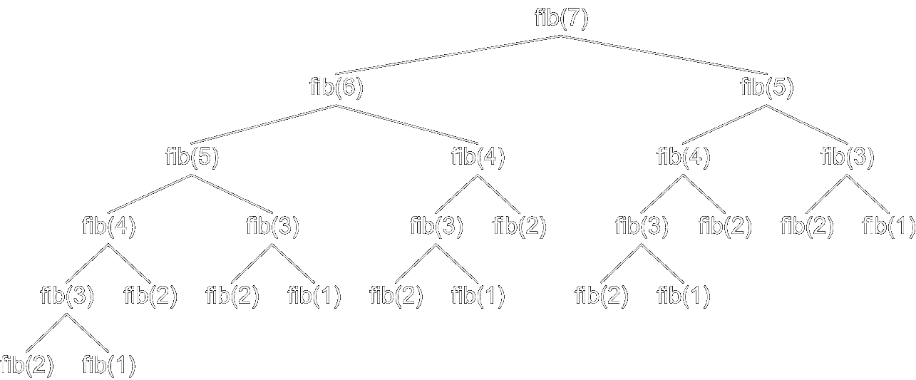
How the Recursive Fibonacci Calculation Works?
fib(n) makes about fib(n) recursive calls
The same value is calculated many, many times!

Slide 48
When to Use Recursion?
Avoid recursion when an obvious iterative algorithm exists
  Examples: factorial, Fibonacci numbers
Use recursion for combinatorial algorithms where
  At each step you need to recursively explore more than one possible continuation, i.e. branched recursive algorithms

Slide 49

Summary
Recursion means to call a method from itself
  It should always have a bottom at which the recursive calls stop
  Very powerful technique for implementing combinatorial algorithms
  Examples: generating combinatorial configurations like vectors, permutations, combinations, variations, etc.
Backtracking finds all solutions / optimal solution of
combinatorial problem by generating all possibilities
  Without non-perspective candidates
Recursion can be harmful when not used correctly

